Slide 1
Strong Coupling between Molecules and Plasmonic Nanostructures
Haotian Cheng, Xinyu Wu, Xinkai Zhang, Qiyue Zhao

Slide 2
Outline
1. Motivation
2. Theoretical background
3. Work about molecules plasmon strong coupling
4. Outlook
Notes:
为什么在plasmonic structure

Slide 3
Motivation
Interactions between individual two-level systems and resonating cavities
- cryogenic temperature
- ultrahigh vacuum
Strong coupling between SPP and emitters within an open cavity
- subwavelength scales
- room temperature
- lowered fabricating difficulty

Slide 4
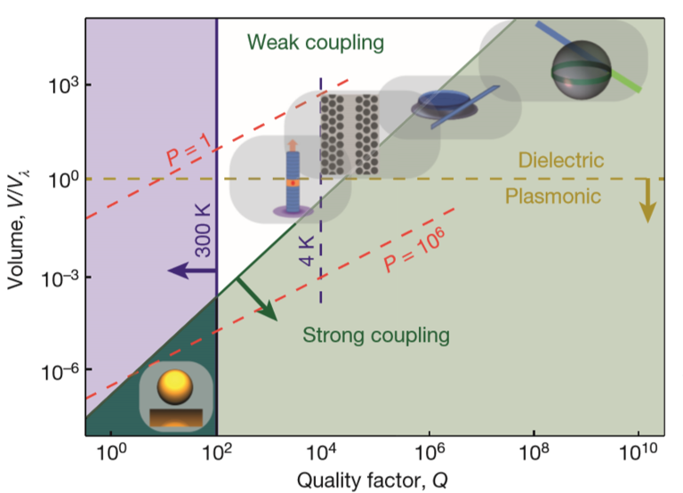
Motivation
Temperature requirement for strong coupling

Slide 5
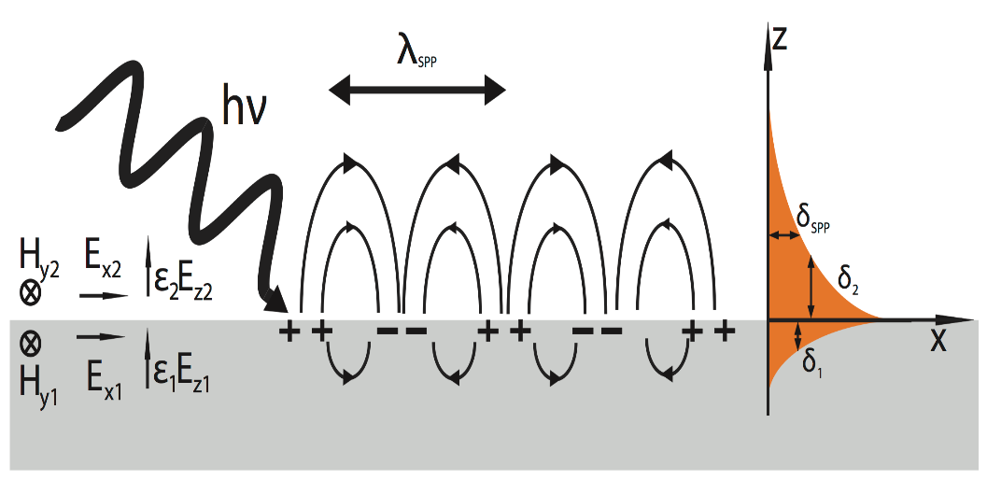
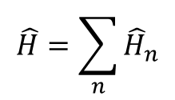
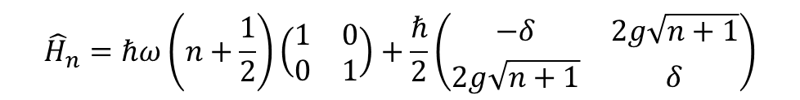

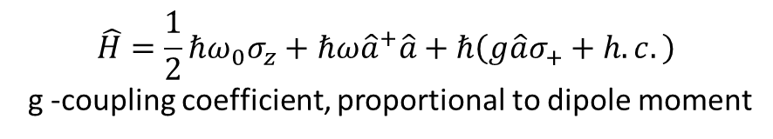
SPP and coupling with single emitter
$$\hat{H}=\frac{1}{2}ℏω_{0}σ_{z}+ℏω{\hat{a}}^{+}\hat{a}+ℏ\left(g\hat{a}σ_{+}+h.c.\right)$$
g -coupling coefficient, proportional to dipole moment
$$\hat{H}=\sum_{n}{{\hat{H}}_{n}}$$
$$\left(\begin{matrix}1 \\ 0\end{matrix}\right)=|\left.e\right\rangle |\left.n\right\rangle \left(\begin{matrix}0 \\ 1\end{matrix}\right)=|\left.g\right\rangle |\left.n+1\right\rangle$$
$${\hat{H}}_{n}=ℏω\left(n+\frac{1}{2}\right)\left(\begin{matrix}1 & 0 \\ 0 & 1\end{matrix}\right)+\frac{ℏ}{2}\left(\begin{matrix}−δ & 2g\sqrt{n+1} \\ 2g\sqrt{n+1} & δ\end{matrix}\right)$$
Notes:
偶极近似和旋转波近似，二能级系统即可，原子，分子，激子，按光子数分解，选定基矢写成矩阵形式

Slide 6
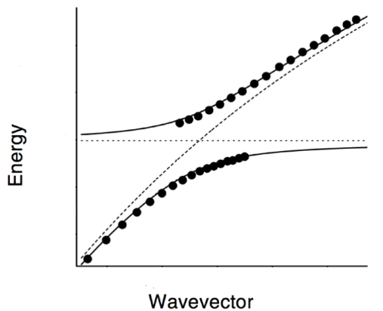
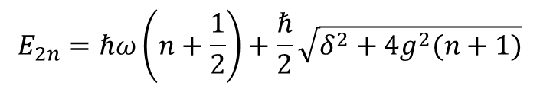
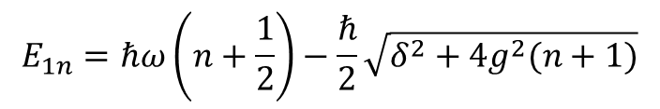



Rabi splitting
$$E_{1n}=ℏω\left(n+\frac{1}{2}\right)−\frac{ℏ}{2}\sqrt{δ^{2}+4g^{2}(n+1)}$$
$$E_{2n}=ℏω\left(n+\frac{1}{2}\right)+\frac{ℏ}{2}\sqrt{δ^{2}+4g^{2}(n+1)}$$
Rabi splitting
$$ℛ_{n}=ℏ\sqrt{δ^{2}+4g^{2}(n+1)}$$
Resonance: $δ=ω−ω_{0}=0$
$ℛ_{n}$= $2ℏg\sqrt{n+1}$

Slide 7
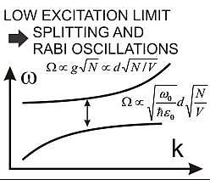



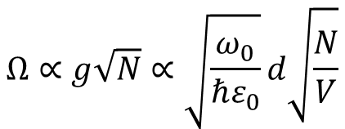
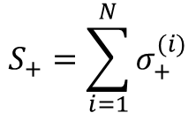
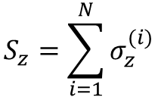
Many emitters
$$\hat{H}=\frac{1}{2}ℏω_{eg}S_{z}+ℏω{\hat{a}}^{+}\hat{a}+ℏ(g\hat{a}S_{+}+h.c.)$$
$$S_{z}=\sum_{i=1}^{N}{σ_{z}^{(i)}}$$
$$S_{+}=\sum_{i=1}^{N}{σ_{+}^{(i)}}$$
Large emitter number and low excited numbers, treated as bosonic system
$$S_{z}={\hat{b}}^{+}\hat{b}−\frac{N}{2}$$
$$S_{+}={\hat{b}}^{+}\sqrt{N−{\hat{b}}^{+}\hat{b}}$$
$$\hat{H}≈ℏω_{0}\left({\hat{b}}^{+}\hat{b}−\frac{N}{2}\right)+ℏω{\hat{a}}^{+}\hat{a}+ℏg\sqrt{N}(\hat{a}{\hat{b}}^{+}+h.c.)$$
$$Ω∝g\sqrt{N}∝\sqrt{\frac{ω_{0}}{ℏε_{0}}}d\sqrt{\frac{N}{V}}$$
Notes:
多个原子，处理成波色系统，按粒子数表象，形式与之前类似

Slide 8
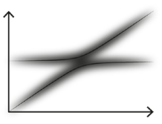
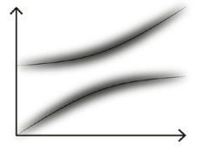
Strong Coupling
Weak coupling
Strong coupling
Rabi split is experimentally observable when splitting is larger than the energy linewidth.

Slide 9
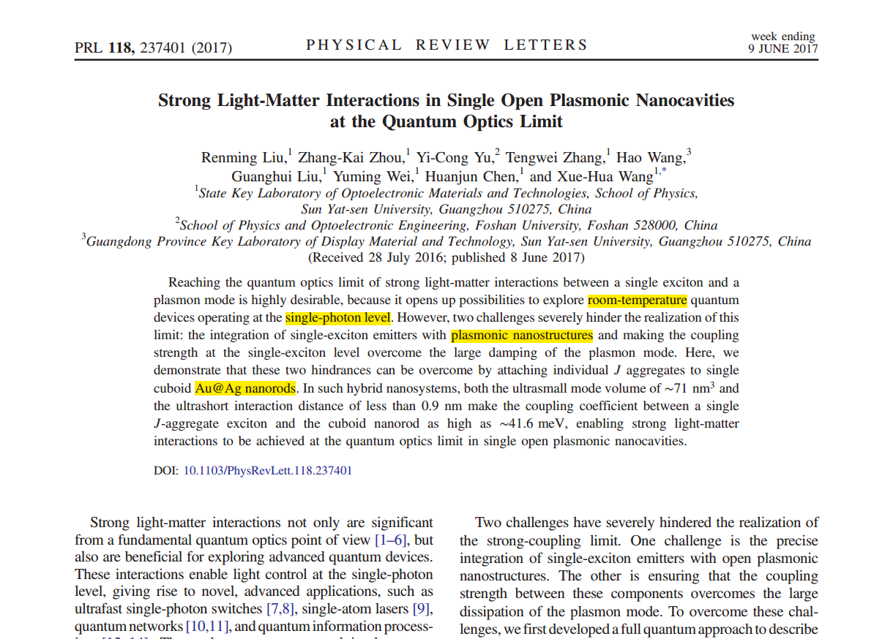
Paper

Slide 10

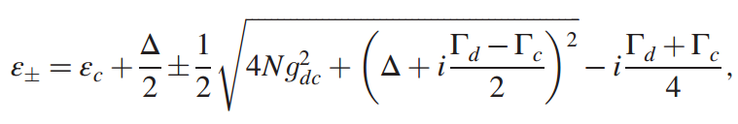
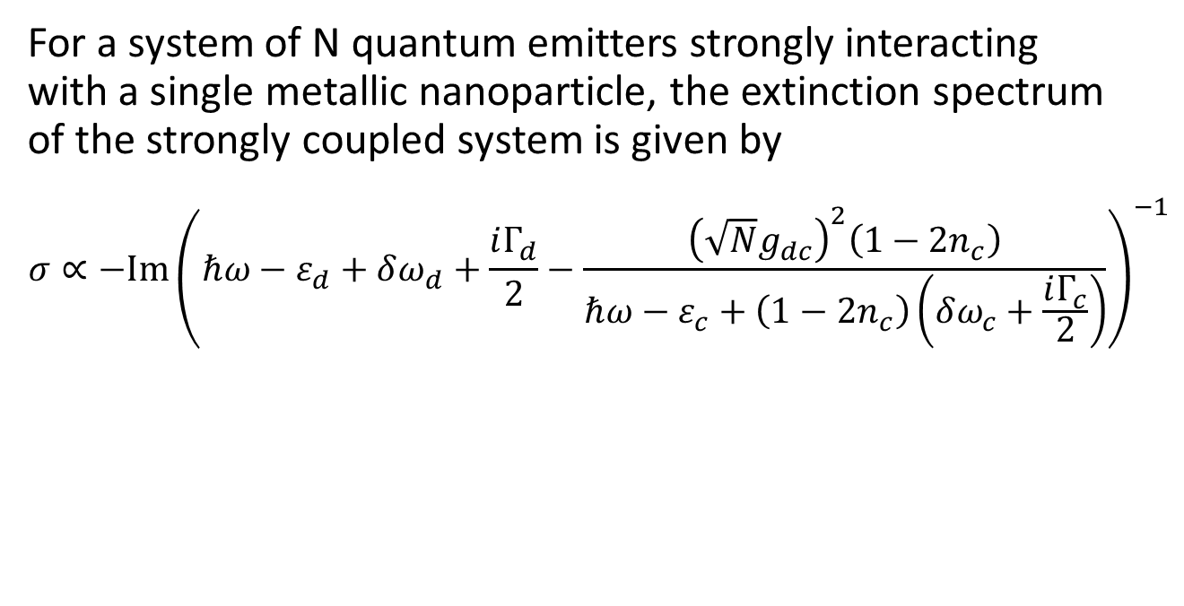
Theoretical Part
For a system of N quantum emitters strongly interacting with a single metallic nanoparticle, the extinction spectrum of the strongly coupled system is given by
$$σ∝−Im{\left(ℏω−ε_{d}+δω_{d}+\frac{iΓ_{d}}{2}−\frac{{\left(\sqrt{N}g_{dc}\right)}^{2}\left(1−2n_{c}\right)}{ℏω−ε_{c}+\left(1−2n_{c}\right)\left(δω_{c}+\frac{iΓ_{c}}{2}\right)}\right)}^{−1}$$
Notes:
LSP，不好用波矢描述，判断依据

Slide 11


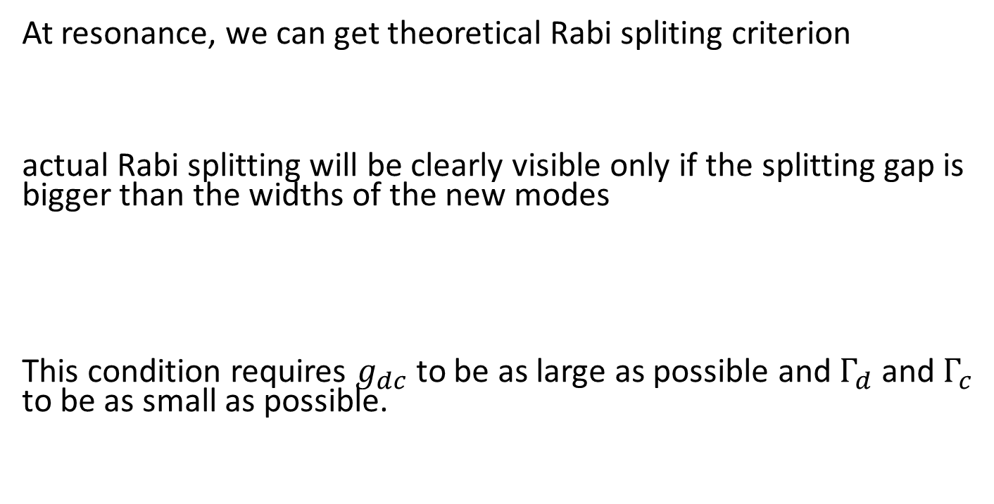
Theoretical Part
At resonance, we can get theoretical Rabi spliting criterion
actual Rabi splitting will be clearly visible only if the splitting gap is bigger than the widths of the new modes
This condition requires $g_{dc}$ to be as large as possible and $Γ_{d}$ and $Γ_{c}$ to be as small as possible.

Slide 12
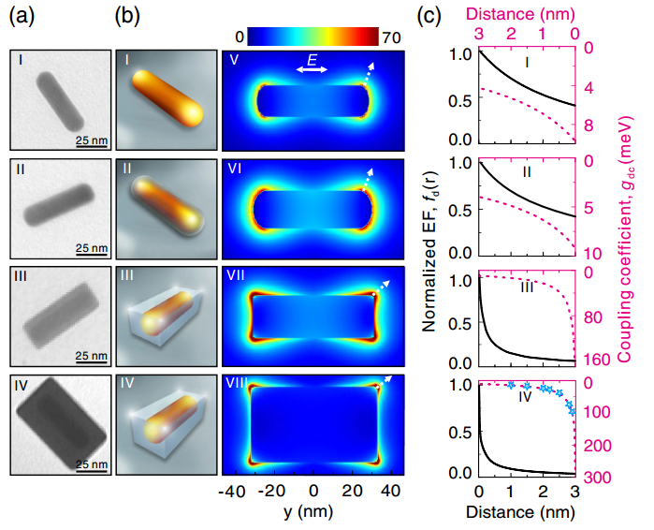
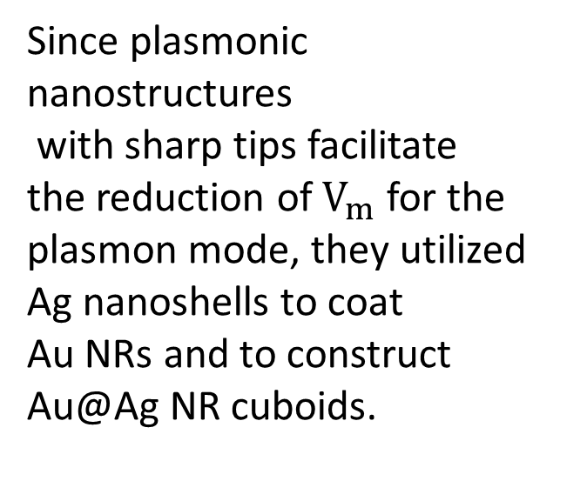
Experimental Result
Since plasmonic nanostructures
with sharp tips facilitate the reduction of $V_{m}$ for the
plasmon mode, they utilized Ag nanoshells to coat
Au NRs and to construct
Au@Ag NR cuboids.

Slide 13
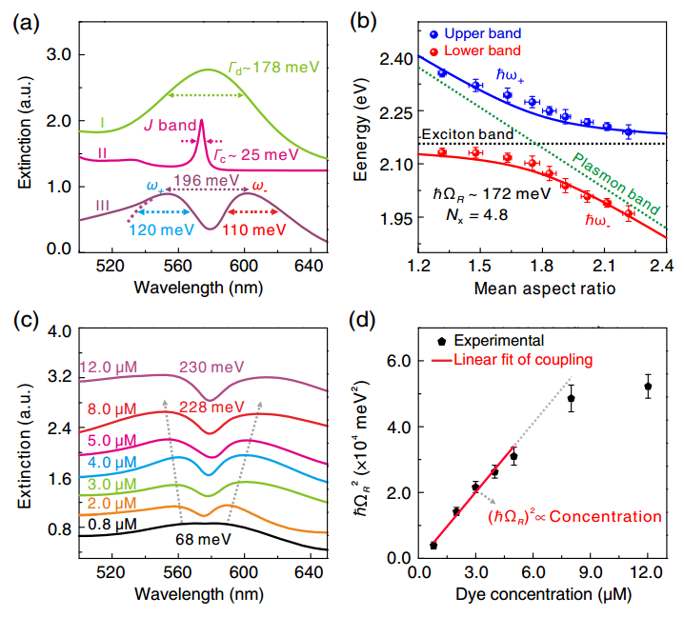
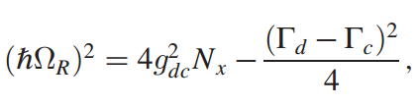
Experimental Result

Slide 14
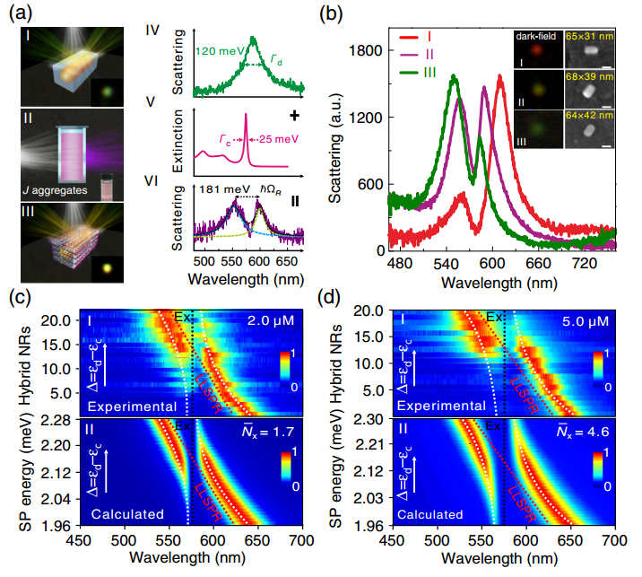
Experimental Result
Notes:
暗场散射，1,2,3 < = >

Slide 15
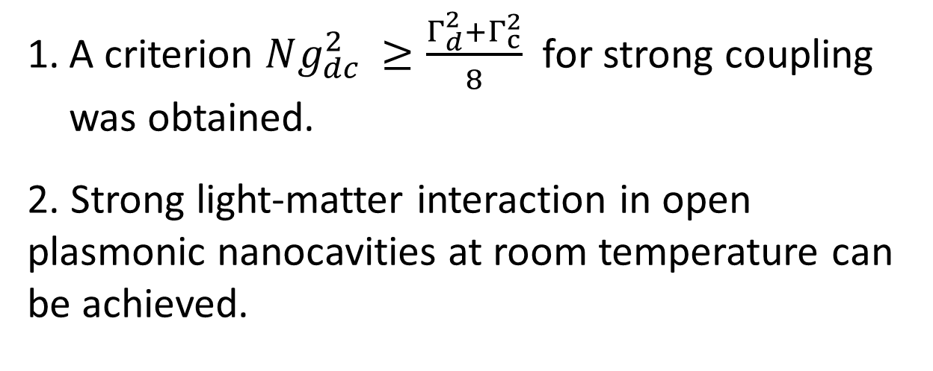
Conclusion
A criterion $Ng_{dc }^{2}≥\frac{Γ_{d}^{2}+Γ_{c}^{2}}{8}$ for strong coupling was obtained.
2. Strong light-matter interaction in open plasmonic nanocavities at room temperature can be achieved.

Slide 16
Outlook
Jaynes-Cummings ladder
Quantum information processing
Thresholdless lasing and lasing without population inversion
Notes:
相互作用很强的时候可以把发射调制到单模，强耦合所带来的相干性

Slide 17
References
1. Strong Light-Matter Interactions in Single Open Plasmonic Nanocavities at the Quantum Optics Limit, R. Liu, X. Wang, 2017
2. Quantum Plasmonics, S. I. Bozhevolney, L. Martin-Moreno, F. Garcia-Vidal, 2017
3. Strong coupling between surface plasmon polaritons and emitters: a review, P. Törmä, W. L. Barnes, 2015
4. Single-molecule strong coupling at room temperature in plasmonic nanocavities, R. Chikkaraddy, J. J. Baumberg, 2016
5. Photon statistics of a cavity-QED laser: A comment on the laser–phase-transition analogy, P.R. Rice, H.J. Carmichael, 1994
6. Lasers without inversion: A closed lifetime broadened system, A. Imamoglu, J.E. Field, S.E. Harris, 1991

Slide 18
Thank you!

